Slide 1
Welcome
Maine State Public Transit Advisory Council
January 28, 2016

Slide 2
Self Introductions
Name
Affiliation

Slide 3
Purpose of Council
Need
Authorizing Legislation
Meeting Schedule, January/June

Slide 4
Your Thoughts
Council Role
Observations about public transit
Unanswered questions about public transit

Slide 5

Maine Strategic Transit Plan 2025
Summary Presentation

Slide 6
Project Management
Sue Moreau
Manager, Multimodal Planning Division
Bureau of Planning
MaineDOT
Notes:
I am Susan Moreau. I managed the development and preparation of the Strategic Transit Plan. I manage the Multimodal Planning Division at Maine DOT in the Bureau of Planning. I've been with the Department for over 15 years. My current responsibilities include managing the public transportation activities of the Department and the passenger rail, ferry service, bike pedestrian and aviation activities as well.
As the manager of a variety of modes in the Department I want to point out that the emphasis in this plan has been on public transit. We had some comments that spoke to renaming the strategic plan as a bus strategic plan because ferry and rail weren't covered, but generally in terms of the nomenclature when you say public transit, it speaks to wheeled vehicles and this plan focuses on that. The plan doesn't ignore the other modes because the connections to the other modes is a function of this plan in terms of one of the performance measures and the experience of riders to have a “seamless” experience when going from a bus to a ferry or from a train to a bus and so forth. While this plan is about wheeled vehicles – buses and vans- the connections to other modes is important and the other modes have their separate plans that they follow.
Maine DOT began working on the Strategic Transit Plan in August 2013. The plan has received the benefit and guidance from a steering committee of 22 individuals who represented transit providers, service users, elected officials and other stakeholders who volunteered their time to attend meetings and read technical materials to provide guidance to DOT. The plan has had two public hearings and a statewide public opinion survey was conducted so I feel confident the plan represents the needs and opinions of Maine residents. The plan represents the first comprehensive approach to improving public transit in Maine since the state first started supporting public transit some 30 years ago. To date efforts to improve public transit in the state have while well intentioned and often fruitful have been ad hoc and not part of a long range improvement process. This plan sets out a long range improvement process and methods to monitor and evaluate public transit for continual improvement and careful stewardship of the available funding.

Slide 7
Two Part Presentation
Part One: Background, Inventory and Actual Conditions
Part Two: Findings, Recommendations and Strategies
Notes:
The presentation I am sharing with you today is divided into two parts. Part one presents the background, inventory and current conditions which were assessed to help select logical directions for the plan.
Part two presents the findings and implications of the current conditions and sets out recommendations and strategies to continually improve public transit in Maine.
Questions are welcome any time but given our limited unless your question is on a particular slide we will have time at the end of the presentation for questions and comments.

Slide 8
The Strategic Concept
Part One
Part Two
Notes:
This is a graphic presentation of the entire strategic planning process. Any strategic plannign process involves answering three questions:
Where are we – what are the existing conditions and strengths, weaknesses and opportunities.
(This is part one of my presentation.)
Where do we want to go – you might think of this as answering the question – what is the vision here? What do we want public transit to look like in the future?
The final question is – how do we get from where we are to where we want to go?
(Part two of my presentation focuses on where we want to go and how we get there – the implementation steps. )

Slide 9
Part 1: Background, Inventory and Actual Conditions
Overview of Project
Maine’s changing population
Funding support for public transit
Analyzing the demand for public transit
Existing funding and cost to continue
Notes:
So lets begin with the project overview and existing conditions.

Slide 10
Purpose and Need for Strategic Plan
Prepare a roadmap with recommendations, strategies and measureable objectives to become better managers of Federal and State funds for improved service to the end user - the customer.
Mandated Maine Legislative and MAP 21 Performance Measures
Streamlining of MaineDOT procedures to be in compliance with FTA regulations and more systematic oversight of sub grantee to improve performance.
Comprehensive inventory and evaluation of what has been unquestioned / unexamined for over 30 years.
Notes:
Some elements of the plan were mandated by the Maine Legislature and some were mandated by elements of the current Federal legislation for transit and highways called MAP 21. Those mandates primarily deal with measuring performance and managing assets owned or funded by the state.
But the overall goal of the plan was to provide recommendations and a roadmap on how to improve the service to the end user – the person who rides the bus or van – the customer.

Slide 11
Business as usual is no longer possible.
-many changes and new demands
Notes:
When we started the plan it quickly became clear that business as usual was not longer possible due to changes in the population of the state and changes in the operating environment.
There have been many changes and new demands place on the services and it is important that the department respond to those changes with a practical and systematic approach that everyone can understand.

Slide 12

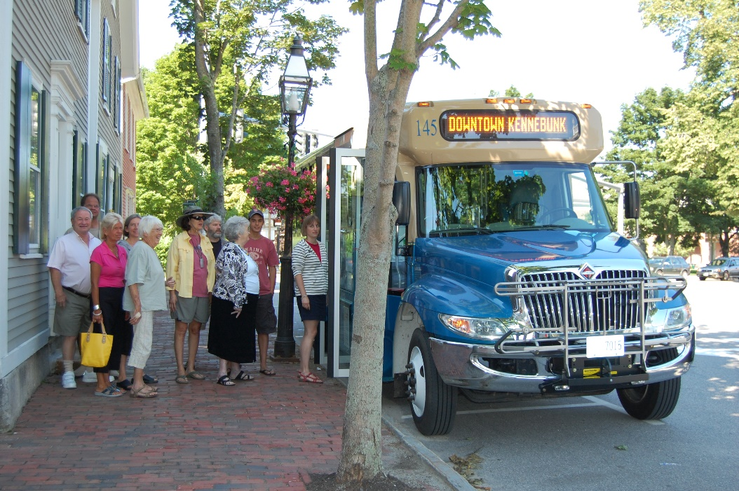
Maine’s Changing Population
Change in population dynamics and notably the growth in the numbers of elderly persons. 2025 projected 78,000 increase. Elderly are major transit riders.
Notes:
The first and one of the most important changes in the operating environment is one that everyone is well aware of yet not fully prepared to address and that is the graying of Maine and America as a whole.
Older persons are major transit riders and as you will see later they are a large disproportionate segment of the current ridership and will be off into the future. Public transit is important to older persons because it helps them stay in their own homes and keeps them out of institutions and thereby saves our state and society funds. Many older people can still cook for themselves and dress themselves but they cannot drive and that is why public transit is so important to older persons.
The next slide shows how the numbers of older persons have changed the look of the population pyramid for Maine.

Slide 13
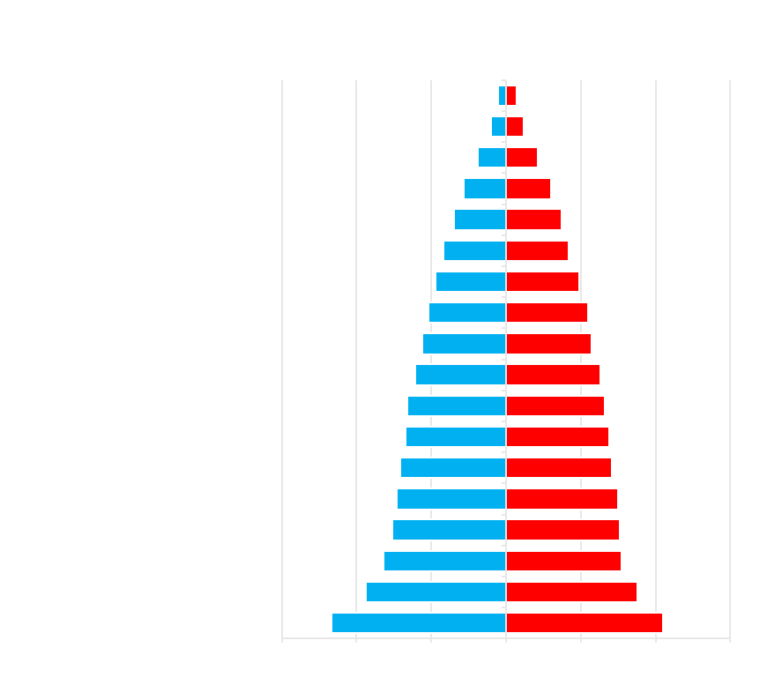
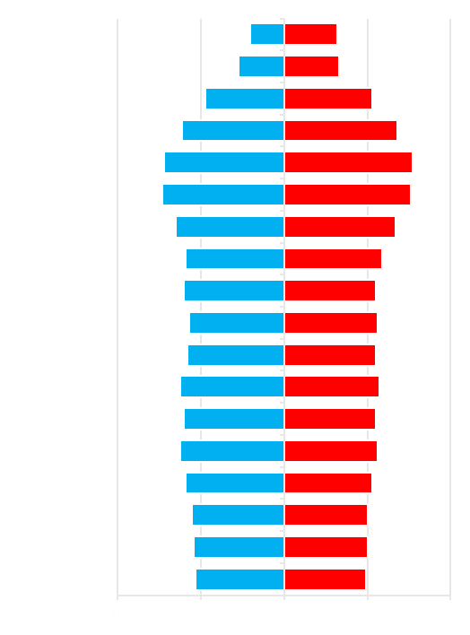
Maine’s population by age group
1950 2025
Male Female - Percentages of Population
Notes:
In 1950 the population pyramid for the state of Maine was what can be described as growing and healthy with a large number of young people. As we know those young people often referred to as the “Baby Boom” are now aging and by 2025 the population pyramid will look like a fire plug as that large group of people have needs for public transit and other services geared to older persons.

Slide 14
How the population is currently served
Inventory of Existing Services
Notes:
In the next series of slides I show how the population of Maine is currently served and the next slide is a map of the state with the regional providers.

Slide 15
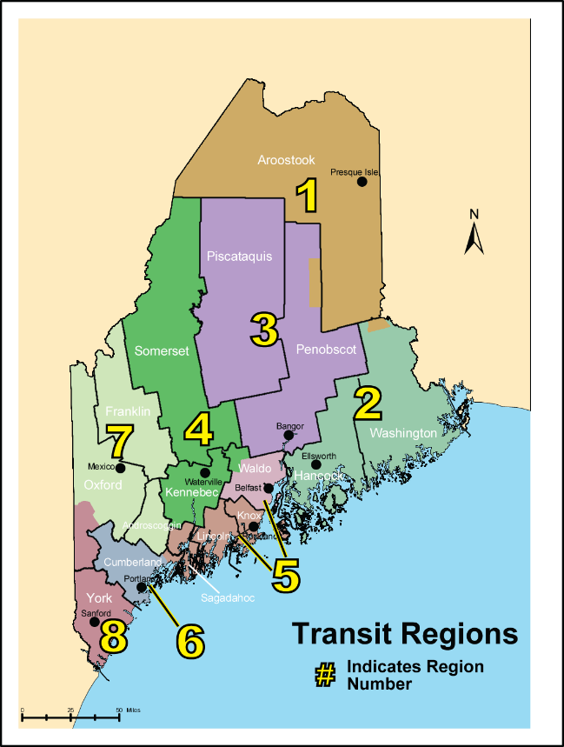
Region | Regional Transit Provider
1 | Aroostook Regional Transportation System (ARTS)
2 | Washington Hancock Community Agency (WHCA)
3 | Penquis Transportation Program (Penquis)
4 | Kennebec Valley Community Action Program (KVCAP)
5 | Coastal Trans, Inc. (CTI)
 | Waldo Community Action Partners (WCAP)
6 | Regional Transportation Program (RTP
7 | Western Maine Transportation Program (WMTS)
 | Community Concepts
8 | York County Community Action Corporation (YCCAC)
Notes:
By Maine state law the Department is charged with designating the regional boundaries of services to provide public transit. The current regions do not follow the current Department’s highway regions nor do they exactly follow county boundaries which for data collection and analysis is problematic. The existing regions were in some ways created out of necessity.
The regions were designated by department 30 years ago essentially following Community Action Program boundaries. These programs had the requisite match which was difficult for local governments to supply and in fact in the early days of the program around 1979 and 1980 there was a problem in spending all the Federal funds because local matching funds were not available.
There are eight transit regions in Maine… These are the regional
providers who have been guaranteed certain funding over the years. It's not all of the providers. It is just a list of the regional ones. There are fixed route providers in the urban areas of the state, flex route providers and so forth. (click to the next slide)

Slide 16
Types of Transit Services
  Intercity
  Commuter
Urban Fixed Route
Rural Fixed Route
Urban Flex Service
Rural Flex Service
Urban Demand Response
Rural Demand Response
Notes:
You heard me mention the different types of services in the state and here is a list of the types of service the state recognizes and funds.
There are different types of transit services. I'll mention these briefly because the plan talks about each one. Each one is different. Fixed route systems, they have a set timetable. We have four of them in Maine. There's a parallel para transit system for persons with disabilities, which means if you're not able to get on a fixed route bus a different smaller bus will meet your mobility needs for that fixed route service.
We have flex route systems. These are generally the smaller systems. They don't have paratransit. They can do route deviation to pick up people. Kennebec Explorer is one example of that.
We have a number of intercity services, some of which are totally private like Concord Coach, others which are supported through DOT. One example would be the Cyr bus line that runs between Bangor and Caribou that receives some support from DOT.
We have seasonal services like the Explorer Acadia system that only operate part of the year. We have two summer seasonal systems that are supported by DOT and two winter systems. Of course there's a lot of privately owned ones that are not part of this mix.
There's also the general public demand response. We don't have much of that, but one good example is in Aroostook County. It is not a taxi or limo service and you can't say I need a ride in ten minutes, but it's a system that's worked well with advance reservations for travel in Aroostook County.

Slide 17
Key points about types of service:
Urban fixed route systems provide the bulk of general public trips
Modest State support for public transit
MaineDOT funds public transit
DHHS provides substantial support for closed door service (not open to public, such as MaineCare and other program specific services)
Notes:
Some points about the different types of services- generally the bigger systems, fixed route systems, they run more frequently, they run more days of the week, the headway, the number of times the bus has come, it's much more frequently. The urban systems in Maine provide the bulk of the public trips right now. We do have systems serving more rural areas, but the bulk of the people being transported by public transit are in the urban areas. There's been minimal support for for public transit, we'll get to that in a minute. But DHHS, Department of Health and
Human Services, provides substantial support for eligible people, primarily people on Maine Care. This is an important concept to remember – The MaineDOT views its role as providing for the entire, general population of Maine with open door public service. DHHS focuses on client eligible services and runs closed door services – you have to be eligible to ride through some screening process for the various DHHS programs that supply closed door service. MaineDOT is all about general public open door services for anyone regardless of the type of trip or how much income a person has or other qualifications.

Slide 18
How the population is currently served
Gaps in Service and Theoretical Demand for More Service
Notes:
Now that we have set out the types of service and the general charactaristics, I want to talk about how the population is served and where there are gaps in service.

Slide 19
Methods for Estimating Demand
Put in place a demonstration
Compare to peer systems and groups
Statistical formula
Notes:
There are three ways to estimate the demand for transit services.
A demonstration
Peer Groups
Statistical Formula
We have taken lessons for this plan from all three methods for estimating demand.

Slide 20
Methods for Estimating Demand
Put in place a demonstration
Essentially this is what the State of Maine has been doing for 30 years. “Given this type of service in this area at this price this is what the demand for service is.”
Notes:
We have essentially had a 30 year demonstration which has shown x number of people will ride this x type of service at this x given price As you will see in a moment our 30 years of experience has not put us in the best light when compared to our selected peer group.

Slide 21
Methods for Estimating Demand
Put in place a demonstration
Compare to peer systems and groups
The Maine Strategic Transit Plan 2025 identified 7 peer states as a group that could be compared to Maine and as you will see Maine does not compare favorably.
Notes:
The second method of estimating demand concerns gauging theoretical demand against services or states that are similar to the area being studied. For our study we identified seven states that have similar characteristics to Maine and I wll show those to you in just a moment.

Slide 22
Methods for Estimating Demand
Put in place a demonstration
Compare to peer systems and groups
Statistical formula
For both the rural and urban areas a statistical formula focusing on gap analysis was conducted.
Notes:
Finally demand can be estimated using a statistical formula. We used a national model for projecting demand and gaps in service.

Slide 23
Estimating Rural Demand
TCRP Report 161
Methods for Forecasting Demand and Quantifying Need for Rural Passenger Transportation: Final Workbook
Transit Cooperative Research Program
Washington, D.C. 2013
Notes:
The method, from the Transit Cooperative Research Program in D.C., it's TCRP Report 161,
for forecasting demand and quantifying the need for rural transportation is based on a statistical analysis of many transit services across the United States. A similar gap analysis was used for the urban areas of the state too.
The statistical formula used shows some systems exceed the theoretical demand but there is overall a need to improve services overall to meet the average performance of the peer group.

Slide 24
TCRP Formula
Number of Households having no vehicle X mobility Gap
What is the Mobility Gap?
Number of trips/household/day in a household with one vehicle (5.0) minus number of trips/household/day with no vehicle (3.3) = 1.7
Mobility Gap of 1.7 is an estimate for New England.
Notes:
The key to the formula is the households with no vehicle and the mobility gap calculated by the TCRP formula for rural areas in New England is 1.7. Urban estimates used specific estimates of gaps for each urbanized area which were provided by each of the urban area planning units.

Slide 25
Page 17 TCRP Report
Quote from page 17 of the TCRP Report:
“In the testing of these suggested methodologies with a number of rural transit agencies, it was found that, at best, only about 20% of the mobility gap trip-based need was met.”
Notes:
On Page 17 of the report in testing the methodologies that were used, it was found that at best only about 20 percent of the mobility gap trip based need was met by public transit. In other
words, you can calculate here's our need, and if you can meet 20 percent of that need, you're doing pretty well and some people are not going to take transit no matter what. Some people will have transportation needs met by other methods.

Slide 26
For both the rural and urban areas of Maine a goal of meeting 20% of the theoretical demand was set.
A few systems exceed that goal but most do not. Average across the state was 17%
Notes:
The 20% measure was used throughout because the statistical formula used shows some systems exceed the theoretical demand but others did not so the 20% measure had applicability across the entire state. Overall there is a need to improve services to meet the average performance goal of 20% and in the next slide you will see the variation in meeting the 20% goal by county.

Slide 27
County Summary of Transit Need and Trips Provided FY 2012
County | Annual Need (Trips) | Trips Provided | Trips Provided as % of Annual Need
Androscoggin | 6,025,200 | 654,002 | 11%
Aroostook | 1,260,600 | 278,172 | 22%
Cumberland | 11,696,100 | 2,099,781 | 18%
Franklin | 410,100 | 90,833 | 22%
Hancock | 705,330 | 115,027 | 16%
Kennebec | 2,131,290 | 310,322 | 15%
Knox | 532,440 | 37,166 | 7%
Lincoln | 191,250 | 23,178 | 12%
Oxford | 772,800 | 178,367 | 23%
Penobscot | 5,788,600 | 1,420,462 | 25%
Piscataquis | 276,930 | 43,029 | 16%
Sagadahoc | 486,000 | 40,507 | 8%
Somerset | 766,540 | 136,829 | 18%
Waldo | 540,000 | 115,009 | 21%
Washington | 594,600 | 81,317 | 14%
York | 3,535,800 | 607,019 | 14%
Total, Maine | 35,713,580 | 6,231,020 | 17%
Table 8 page 33
Notes:
The statewide average for meeting the 20% goal is 17% and as you can see the counties range from a high of 25% in Penobscot County to a low of 7% in Knox County. The variation has to do with the amount and type of transit provided in each county and with the efficiency and effectiveness of the providers in each county – and efficiency and effectiveness are areas that we will be more closely monitoring and working to improve on all fronts.

Slide 28
Service | 2012 Trips | Percent of Theoretical Demand Met
Citylink (Lewiston-Auburn) | 350,604 | 7%
Community Connector (Bangor) | 1,010,319 | 21%
Metro (Portland) | 1,464,643 | 15%
South Portland Bus | 247,370 | 26%
Urban Group | 3,072,936 (Total)
27 other Services Primarily Rural | 3,878,860 (Total)
Notes:
As you can saw from the previous slide the more urban counties are providing the most trips and this slide shows the percentages for the four urban systems in the state. While the urban systems receive their operating funding directly from the Federal government the state has funded capital expenses in the urban area which with just four systems provide 3 million trips compared to the other 27 service providers which provide 3.8 million trips.

Slide 29
Federal and State Funding for Transit
Notes:
I have presented the types of services provided in Maine and theoretical demand for service so now let’s examine the funding for public transit in Maine.

Slide 30
Federal Financial Support from FTA to Transit Services and Activities in Maine FY 2012
FTA Program | Program Name | FY 2012 Funding Amount
§5303 | Planning Program | $374,538
§5304 | State Planning Program | $98,570
§5307 | Urban | $4,162,847
§5310 | Elderly, Persons with Disabilities | $741,596
§5311 | Non-Urbanized Formula (Rural) | $5,434,988
§5311(b) | RTAP | $115,593
§5316 | Job Access, Reverse Commute, Rural | $340,467
§5316 | Job Access, Reverse Commute, Urban | $311,805
§5317 | New Freedom, Rural | $217,097
§5317 | New Freedom, Urban | $221,882
 | Small Transit Intensive Cities | $263,030
Total |  | $12,282,413
Notes:
(Report reference Table 3 page 11)
This slide shows the Federal monies that came into the state to support a variety of transit activities in fiscal year 2012. It is important to note that the state has direct recipients of 5307 Federal funds and the DOT does not administer those funds. The largest single source is the 5311 funds for rural areas and the state does administer those funds by making grants to individual projects across the state.

Slide 31
Maine State Funding for Transit
FY 2011: $530,026
FY 2012: $547,845
FY 2013: $547,845
Notes:
(Report reference page 12)
While the total Federal funds to support transit have been growing over the years the state funding has been flat in the $500,000 range. This is better illustrated in the next slide.

Slide 32
FTA and State of Maine Dollars Invested in Public Transportation
Notes:
(Report reference Figure 2 page 13)
Here we see for the nearly past 20 years the state funding has been flat while the Federal funding has increased. It should be noted that the large increase in 2013 was due to the Portland Area Comprehensive Transportation System receiving more Federal Funds.

Slide 33
“Peer State” Per Capita State Funding
For Public Transit (FY2010)
( Data Source: AASHTO Survey of State Funding for Public Transportation 2012. )
Notes:
The 50 State National Average (as of 2007– latest available) was $45.66. However as is shown Maine on a per capita basis is funding transit at a modest level when compared to the seven selected peer states. The peer state average is $2.82 and Maine funds transit at the $0.40 level.

Slide 34
“Peer State” Sources of State Funds for Public Transit
General fund
  Unrestricted state highway funds (excludes gas tax)
Fuel taxes
  Off-road vehicle fuel tax
  State gas tax
  State diesel tax
Motor vehicle/Rental car sales tax
  Rental vehicle taxes.
  Vehicle purchase and use tax
Registration/license/title fees
  Vehicle title fees
  Vehicle registration fees
  Vehicle license fees
Funds for capital expenditures
  State bond funds
  Mineral royalty fees
Notes:
When the peer states were examined for their funding sources a variety of sources were found but as is shown in the next slide only a few could apply to Maine.

Slide 35
Maine Sources of State Funds for Public Transit
General fund
  Unrestricted state highway funds (excludes gas tax)
Fuel taxes
  Off-road vehicle fuel tax
  State gas tax
  State diesel tax
Motor vehicle/Rental car sales tax
  Rental vehicle taxes.
  Vehicle purchase and use tax
Registration/license/title fees
  Vehicle title fees
  Vehicle registration fees
  Vehicle license fees
Funds for capital expenditures
  State bond funds
  Mineral royalty fees
Yellow shows Maine funds that can be used for transit
Notes:
The yellow items show two legal, eligible current funding sources for the State of Maine and the challenge of these limited funding sources is shown on the next slide.

Slide 36
The Challenge of Finding State Funds for Public Transit in Maine for Administration & Operations
Public transit does not receive any funding from the General Fund because it is a function within MaineDOT.
MaineDOT is funded through the Highway Fund.
Public transit is constitutionally and legislatively prohibited from using monies collected in the Highway Fund.
Notes:
(Note: The discussion for slides 32 and 33 is linked so advance to next slide where shown)
In Maine, Other Special Revenue Funds (OSRF) are collected and split among recipients based on the specific legislation of the OSRF. Maine’s General Fund shares a relatively small portion of funds collected in OSRF’s primarily dedicated to the Highway Fund. These include the gasoline tax, motor vehicle registration and license fees, and operator license fees.
Again, other states use these sources of funds for public transportation but the Maine State Constitution and legislation does not allow the use of these funds for purpose other than highways and bridges and state enforcement of traffic laws.
(click to next slide to continue discussion)

Slide 37
Source of State Funds in Maine for Admin & Operations is the Multimodal Transportation Fund
  Public Transit is funded through the Multimodal Transportation Fund.
  The Multimodal Transportation Fund receives funds from a portion of the sales and use tax on rental vehicles, the Railroad Company Tax, and the Aeronautical Fuel Tax.
  Multimodal Transportation Fund is used for multimodal forms of transportation, including, but not limited to, transit, aeronautics, marine and rail.
Notes:
The Multimodal Transportation Fund is an OSRF program within MaineDOT. It is the only source of state funds for public transit in Maine.
The purpose of the Multimodal Transportation Fund is to purchase, operate, maintain, improve, repair, construct, and manage multimodal forms of transportation, including, but not limited to, transit, aeronautics, marine and rail.
The Multimodal Transportation Fund receives funds from a portion of the sales and use tax on rental vehicles, the Railroad Company Tax, and the Aeronautical Fuel Tax, and may accept other sources. (Source: 23 MSRA 4210-B) There is not a defined distribution of accrued funds by mode of transportation

Slide 38
State Funding Review
Summary
A review of Maine’s peer states did not reveal a new potential source of state funds for public transit.
Funding sources allowed by the constitution and law for public transit in Maine are problematic and no single solution comes to the fore. Lottery revenue has potential, especially if it can be tied directly to a specific benefit.
Notes:
MaineDOT uses benchmarking on performance measures related to roadways with Idaho, New Hampshire, North Dakota, and Vermont. Three other peer states were added for this plan: Montana, West Virginia and Wyoming.
The productivity and performance of Maine transit systems is below peer group averages and national averages on the performance measures presented in this plan.
Vermont is particularly progressive and a leader among the peer group states in use of performance measures and the use of FHWA “flex funds.”
A review of Maine’s peer states did not reveal a new potential source of state funds for public transportation.
Funding sources allowed by law for public transit in Maine are problematic and no single solution comes to the fore. Lottery revenue has potential as a source of funds for public transportation, especially if it can be tied directly to a specific benefit such as funding transportation options for elderly and disabled persons in rural areas.

Slide 39
Existing Costs and Productivity
Notes:
As I just mentioned Maine is below the peer group average for several key measures and in this section I will share information on costs and productivity.

Slide 40
Maine Transit Services Summary of 2012 Total Administrative and Operating Costs to Meet 20% of Transit Need
Service Type | Trip Gap (Trips) | Lowest Trip Cost | Lowest Total Cost | Average Trip Cost | Average Total Cost
Fixed Route | 730,350 | $2.35 | $1,716,323 | $3.70 | $2,702,295
Flex Route Urbanized Area | 238,099 | $6.65 | $1,583,358 | $6.65 | $1,583,358
Flex Rt. Small Rural Cities | 164,102 | $4.61 | $756,510 | $9.18 | $1,506,456
Flex Route Rural | 63,642 | $14.15 | $900,534 | $14.86 | $945,721
Demand Response Rural Co. | 304,978 | $7.66 | $2,336,132 | $15.71 | $4,791,205
Total | 1,501,171 | $4.86 | $7,292,857 | $7.68 | $11,529,035
Notes:
(Report reference table 12 page 54)
This table shows the costs for the five principal types of services. Note that the fixed route services which are located in the urban areas have the lowest average cost per trip and provide the most trips on an annual basis. The services that are more demand responsive are more expensive to provide because often the service is based on one or a few people to a destination while in the urban areas it is many people to many destinations.

Slide 41
Trip Gap Summary
Service Type | 20% of Trip Need | Trips Provided | Trip Gap (Trips) | % of State’s Total Trip Gap
Fixed Route | 4,124,840 | 3,712,211 | 730,350 | 49%
Flex Route Urbanized Area | 523,860 | 285,761 | 238,099 | 16%
Flex Route Small Cities | 530,460 | 404,304 | 164,102 | 11%
Flex Route Rural | 259,986 | 196,344 | 63,642 | 4%
Demand Response | 1,703,570 | 1,512,792 | 304,978 | 20%
Total | 7,142,716 | 6,111,412 | 1,501,171 | 100.00%
Notes:
(Report Reference: table 15, page 58)
This table shows the trip gap summary for the five principal types of services. Here we see the largest trip gap is in the urban areas. Additional capital and operating funds will be needed to meet the 20% of transit needs in urban and rural areas. Where should those additional dollars be concentrated? Approximately two thirds (65%) of the state’s estimated total trip gap (1,501,171 trips) are in two categories – fixed route (49%) and flex route urbanized area (16%) and include a total of three providers: Metro and Citylink in the fixed route category, and ShuttleBus in the Flex Route Urbanized Area category. Another 11% of the state’s total trip gaps are in the flex route small cities category and include another three providers: Bath City Bus, Brunswick Explorer, and Kennebec Explorer. The service areas of these six providers account for 75% of the state’s estimated unmet trip need. Table 15: Trip Gap Summary shows where additional capital resources for increased service to address trip gaps would be needed.
A precise calculation of the capital investment needed is beyond the scope of this plan because it would necessitate a study of underperforming systems and how they could be improved and/or whether new systems should be supported. Moreover, the need for additional capital will change over time as MaineDOT shifts existing resources from “closed door” MaineCare type services to general public transit systems, and as brokers use more private vendors, rather than public agency vehicles, to transport their customers in some parts of the state.
In summary, an estimate of future capital needs can be determined by using a ratio of total FY 2012 administrative and operating costs ($61,690,911) to vehicle costs (using average yearly vehicle replacement costs of $9.5 million) and assuming a similar ratio between the lowest administrative and operating costs ($61,690,911 plus $7.4 million) to meet the 20% need and vehicle costs. This ratio results in total vehicle costs of $10.6 million, or an additional $1.1 million per year. Using similar ratios, the increase in administrative and operating costs $14 million) would result in total vehicle costs of $11.7 million, or an additional $2.2 million per year.

Slide 42
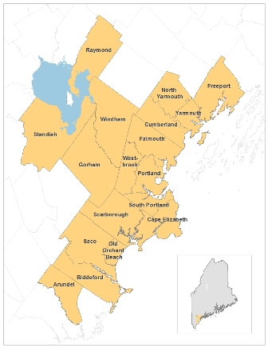
Major point of previous slide:
Two thirds (65%) of the total unmet need is concentrated in urban areas.
For example, Bangor and Portland urbanized areas
Notes:
The urban areas have the highest theoretical demand for trips and lowest cost to provide trips. A key question is how to fairly allocate funds between the urban and rural areas of the state.

Slide 43
Summary of major points
to maintain existing services:
The administration and operating costs can be expected to increase from $20 million in FY 2015, to $23.2 million by 2025, an increase of 16%, assuming an annual inflation rate of 1.5%.
The average capital costs to maintain current level of service is $9.5M per year.
Total costs range between $29.5M in FY 2015 to $32.7M by FY 2025.
Notes:
Costs are expected to increase over the period of the plan and there is a shortfall in the projected funds to meet 20% of the need and the available funds. So just to maintain services $29.5 million to $32.7 million will be needed to continue services.
Double check the following before using: As it stands now only about $X million is available.

Slide 44
Summary of major points
to expand services to 20% of demand:
Additional administration and operating costs range between $7.4 million and $13.9 million (FY2013).
Additional capital costs range between $1.1M and $2.2M.
Total annual additional costs range between $8.5M and $16.1M.
Notes:
The plan assessed the funding needs to expand services to meet 20% of the theoretical and depending on whether the lowest best cost per trip was used or the average cost was used an additional $8.5 million to $16.1 million would be needed over and above the previous slide showing that just to maintain services $29.5 million to $32.7 million will be needed to continue services.
So the total to maintain and expand services is somewhere between $38 million and $49 million for annual expenditures.

Slide 45
Cost Summary
To Maintain what exists
Annual $29.5M in FY 2015 growing incrementally to $32.7M in FY 2025.
To Expand to meet 20% of theoretical demand
Additional $8.5M to $16.1M annually depending on whether estimated using lowest cost or average cost per trip.
Notes:
To expand and meet 20% of the theoretical need it will require between $38 million and $49 million annually depending on whether the estimate is based on the best costs of current services or the average cost of all current services.

Slide 46
Part 2: Findings, Recommendations and Strategies
Peer state review
Surveys and findings
Recommendations for improving public transit in Maine
(Where do we want to go and how do we get there?)
Notes:
It became clear that the monies that were required in the framework of the constitutional limits of Maine that finding and allocating additional monies was problematic so the focus of the remainder of the presentation is on a variety of recommendations beyond finding more funds for transit.

Slide 47
Peer State Review and
Best Practices
How does Maine compare to other states?
Notes:
This section answers the question – how well is our demonstration of 30 years functioning?

Slide 48

Maine’s “Peer States”
Idaho
Montana
Wyoming
North Dakota
New Hampshire
Vermont
West Virginia
Notes:
Seven states were selected on a variety of factors not the least of which – do they have snow? The seven states are shown on this slide.

Slide 49
“Peer State” Performance Measures
2012 Median Agency Farebox Recovery Ratio
Peer state avg. 5.4%
Data Source: Table 37. Rural Transit Fact Book 2014 (from Rural National Transit Database. 2012)
Notes:
This chart is for 5311 rural only. Service type is deviated fixed route, fixed route AND demand response. As you can see Maine is in the lower area for cost recovery from the farebox.

Slide 50
“Peer State” Performance Measures
2012 Median Agency Operating Expense per Mile
Peer state avg. $3.04
Data Source: Table 37. Rural Transit Fact Book 2014 (from Rural National Transit Database. 2012)
Notes:
Once again this chart is for rural 5311 non-sponsored trips public trips…. The data is for combined fixed route and deviated fixed route. Here we see Maine is on the high side of operating expense per mile and is exceeded only by New Hampshire in the peer group.

Slide 51
“Peer State” Performance Measures
2012 Median Agency Deviated or Fixed Route Trips / Mile
Peer state avg. 0.43 mi.
Data Source: Table 37. Rural Transit Fact Book 2014 (from Rural National Transit Database. 2012)
Notes:
This chart is for rural 5311 service and shows that for passenger trips per mile of service Maine is in the lower portion of the peer group states.

Slide 52
“Peer State” Performance Measures
2012 Median Agency Fixed Route Trips / Hour
Nat’l. avg. 10.8 trips/hr.
Data Source: Table 37. Rural Transit Fact Book 2014 (from Rural National Transit Database. 2012)
Notes:
An important measure in transit is the passenger trips per hour of service. Once again Maine is in the lower portion of the passenger trips per hour for fixed route trips.

Slide 53
Summary of Peer Group Analysis
Maine public transit in general has higher costs, and lower productivity when compared to its peer states.
Efficiencies and improvements are possible given current administrative and operating costs and service procedures.
Notes:
This slide says it all and it appears from a review of the data from peer states that there is room for improvement.

Slide 54
Surveys and Findings
Telephone survey and
on-board passenger survey
Notes:
Another key component of the strategic plan was assessing public opinion about transit. Two surveys were conducted. At statewide public opinion telephone survey and a survey of transit riders in Maine.

Slide 55
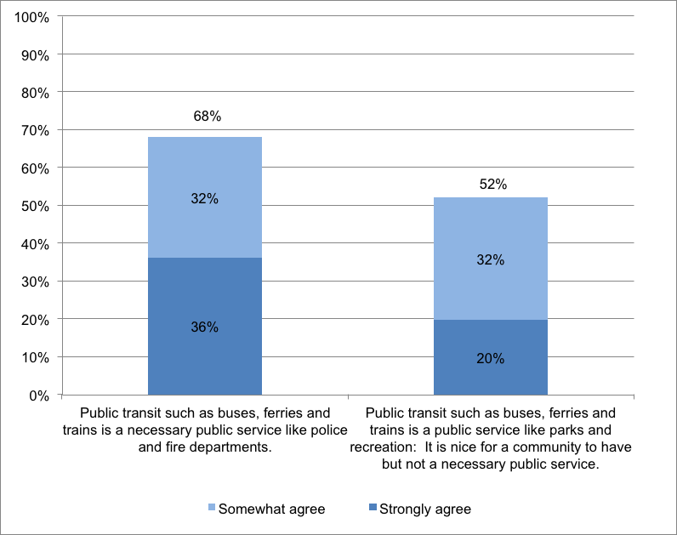
Random Statewide Telephone Survey Results
68% agree public transit is a necessary public service.
Notes:
The results of the telephone survey are shown on the next few slides. People agree that public transit is a necessary public service.

Slide 56
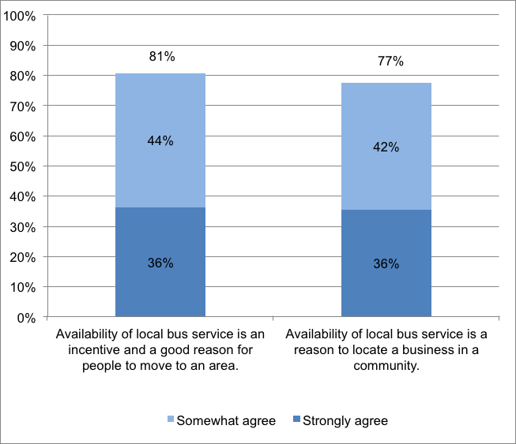
Random Statewide Telephone Survey Results
Most agree bus service is good for the local economy!
Notes:
Most agree that bus service is good for the local economy.

Slide 57
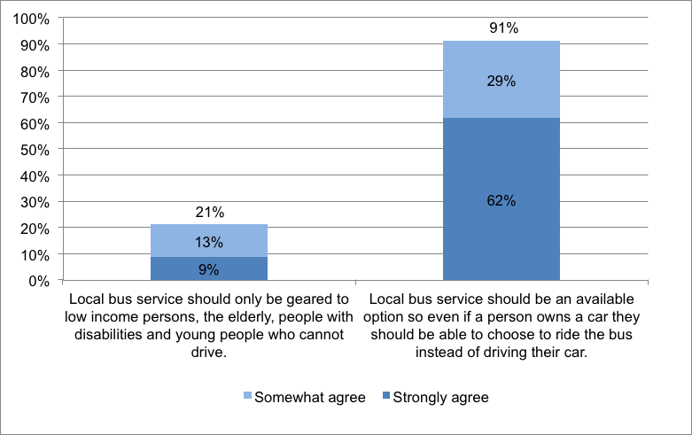
Random Statewide Telephone Survey Results
91% agree, buses should be option for all.
Notes:
A large majority agree that buses should be an option for all and not just for persons who are elderly or persons that are disabled.

Slide 58
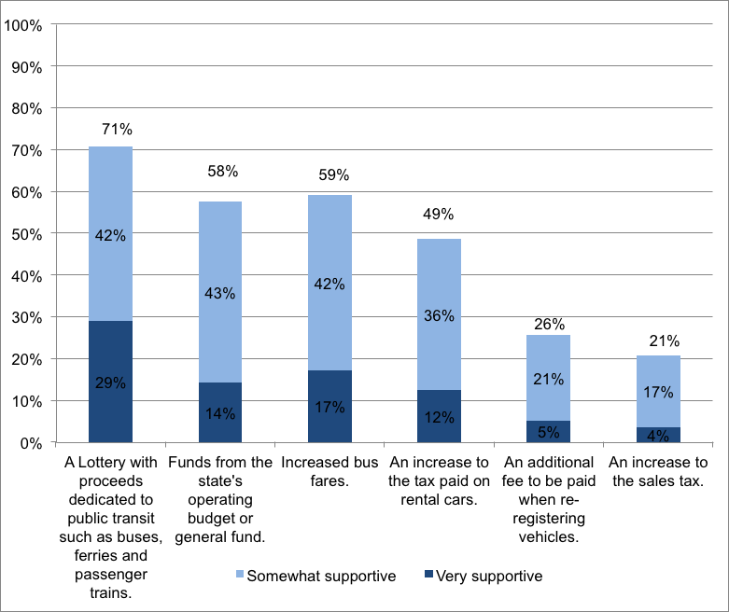
Random Statewide Telephone Survey Results
Most support for lottery, operating budget funds and fares to fund public transit.
Notes:
While tax increases to fund transit were not supported other sources like a dedicated lottery were considered a good way to fund public transit.

Slide 59
Random Statewide Telephone Survey Conclusions
There is wide support to expand public transit options for everyone.
While a majority of Mainers oppose tax increases to fund public transit, some combination of a lottery, state general fund, and higher fares for improved service could draw majority support.
Based on experience in other states, expanding and funding public transit can be done by developing a good plan that the public can understand and support, and that policy makers and elected officials can champion.
Notes:
Here are the major conclusions from the telephone survey and while encouraging they do represent a challenge when it comes to finding additional funding support for public transit.

Slide 60
On-board rider survey of 21 transit systems Conclusions
People who currently use public transit statistically represent lower income and older persons. Almost one half of the passengers on public transportation did not have a vehicle available to them at any time.
People taking public transportation in rural Maine were more likely to be going to or from shopping or medical appointments; 45% of people in urban areas were going to or from work.
There was a high level of satisfaction with public transit among passengers on all types of service…especially with flex service.
Notes:
Passengers on public transportation in Maine had substantially lower incomes and were older than the general population of the state. (With more than two-thirds of all riders having household incomes of less than $25,000, the cost of a fare to ride public transportation is a factor to consider when designing public transportation services.)
Public transportation riders in Maine rode transit primarily to go to or from work, shopping, or medical appointments, and significantly less so for visiting family and friends, school, recreational activities, or running errands.
People taking public transportation in rural Maine were more likely to be going to or from shopping or medical appointments; 45% of people in urban areas were going to or from work.
Passengers on public transportation in Maine were very satisfied with the service they received, and most would recommend its use to family and friends.

Slide 61
Recommendations for Improving Public Transit in Maine
Notes:
My next series of slides concerns the specific recommendations for improving public transit in Maine.

Slide 62
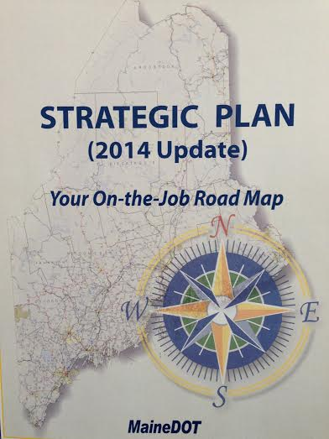
MaineDOT Strategic Plan 2012
MaineDOT’s stated mission is:
“To responsibly provide our customers with the safest and most reliable transportation system possible given available resources.”
Notes:
The mission for the entire plan comes from the departments overall strategic plan which says
“To responsibly provide our customers with the safest and most reliable transportation system possible given available resources.”
Operative words…given available resources.

Slide 63
MaineDOT Strategic Plan 2012
Goals of the department are the
adopted goals of Strategic Transit Plan 2025:
    Manage the Existing System.
    Support Economic Opportunity.
    Build Trust.
Notes:
The specific objectives, strategies, and recommendations regarding public transportation developed during the Maine Strategic Transit Plan 2025 process align with and complement Strategic Plan 2012 goals. The goals of the department which are the adopted goals of the Strategic Transit Plan are:
Manage the Existing System. Effectively manage Maine’s existing transportation system for safety and effectiveness within reliable funding levels.
2. Support Economic Opportunity. Wisely invest available resources to support economic opportunity for our customers.
3. Build Trust. Demonstrate our core values of integrity, competence, and service, both individually and organizationally.

Slide 64
Goal 1: Manage the Existing System. Effectively manage Maine’s existing transportation system for safety and effectiveness within reliable funding levels.
Recommendations:
  Improve and Update the State Management Plan
  Elevate and Clarify the Message that MaineDOT’s Focus is on General Public Transportation
  Administer State, Federal, and Local Funding for Public Transportation
  Improve the Grant Decision Making Process
Notes:
These are the specific recommendations that are part of the plan. Importantly all the recommendations and any changes must be incorporated in the Federally mandated State Management Plan for transit which sets out the specific duties and responsibilities of the department and the sub-grantees.

Slide 65
Goal 1 (con’t): Manage the Existing System. Effectively manage Maine’s existing transportation system for safety and effectiveness within reliable funding levels.
Recommendations:
  Use Population Density of a Geographic Area to Determine Types of Service Offered
  Use a Demand Based Capital Priority Setting Process
  Establish and Use Performance Measures and provide technical assistance to increase the efficiency and effectiveness of sub-grantees.
Notes:
While there is a series of recommendations a theme should be noted throughout and that is that demand and population density are significant factors when designing and funding services.

Slide 66
Goal 2: Support Economic Opportunity. Wisely invest available resources to support economic opportunity for our customers.
Recommendations:
Support General Public Transportation Systems
Support a Mix of Transit Services
Support New Systems and Expand Existing Services
Encourage Volunteer Networks and Alternatives to Traditional Transit Services.
Notes:
For Goal 2: Support Economic Opportunity the plan emphasizes the mix of services needed including volunteers to have a viable transit service that boosts the economic vitality of an area and makes it a better place to live and do business.

Slide 67
Goal 2 (con’t): Support Economic Opportunity. Wisely invest available resources to support economic opportunity for our customers.
Recommendations:
Provide incentives for local communities and transit providers to leverage new sources of private funding for transit services.
Explore ways to Increase State and All Sources of Potential Funding for Public Transportation
Notes:
Importantly as part of the effort to wisely invest available resources to support economic opportunity for our customers we are looking at ways to incentivize and encourage more local and private support of transit. The L.L. Bean company provides significant support for some of the summer services and this concept is one that deserves further discovery on how more private support of transit can be gained.

Slide 68
Goal 3: Build Trust. Demonstrate our core values of integrity, competence, and service, both individually and organizationally.
Recommendations:
Establish a Public Transportation Advisory Group
Expand Education, Outreach, and Marketing
Reinvigorate Provisions of Maine Revised Statutes Title 30-A, Part 2, Subpart 5, Chapter 163 Concerning Regional Transportation Corporations and Transition to Government or Quasi-governmental Governing Bodies
Notes:
Trust is the first requirement for any activity and the Department is establishing a public transit advisory committee to insure that all the possible recommendations are fully vetted by stakeholders and users of the services to help insure success. We recognize that part of that effort is educating and providing outreach so more people understand the availability of public transit.
Lastly the recommendation to invigorate legislation concerning Regional Transportation Corporations has to do with making sure the activities funded by the Department are fully linked to those governmental and elected bodies where the service operates.

Slide 69
Next Steps
By understanding the central problem facing public transit and guided by the recommendations we are developing specific strategies to meet the need
Notes:
Our next steps are wide and varied but we anticipate phasing in the key recommendations over the next 24 months.

Slide 70
Summary of Problem
Demand Exceeds Supply
Unmet Demand
Demand
Supply
Notes:
As I near the conclusion of my presentation I feel it is important to summarize what the central problem facing the Department is. The central problem facing the department when it comes to public transit and other activities is current and projected demand (especially for elderly persons) exceeds supply and the demand will continue to grow in future years.

Slide 71
Specific Strategies
Reduce Demand
Increase supply
Market Size Reduction
  Reduce Eligibility
Price Increases
Product Changes
  Service Design
  Prioritization
  Marketing
Funding Increases
Efficiency Increases
  Coordination
  Administration
  Organization
  Monitoring
  Planning
  Technical Support
Cost Reductions
Notes:
How the Department addresses the central problem of demand exceeding supply will be require a multi-faceted approach. As an overview I offer the following:
Market Size Reduction: While the services are required to be open to the general public –services can be designed that maximize participation by certain groups or areas of people which effectively reduces the eligibility for the service.
Price increases can occur both through increasing the fare and decreasing the frequency or availability of the product similar to what manufacturers are doing now with making the volume of a package smaller yet charging the same price.
Our emphasis will be on product changes in service design, customer services and marketing.
Increasing the supply is typically done in the public sector by increasing the funding but we realize the difficulty of that so our emphasis will be on efficiency increases and cost reductions through technical support and increased monitoring of the services.

Slide 72
Realizations
Total annual additional costs range between $8.5M and $16.1M to meet 20%.
Funding increases of this magnitude are unlikely so focus is on service design, cost reductions and efficiency.
Each service provider funded by the state will engage in a detailed service analysis and plan culminating in a revised service delivery program in 2017.
Notes:
While the Department will focus on efficiency and effectiveness of the current and future services we have come to realize certain realities. Increasing the services to meet the 20% goal will require additional funding and that funding is difficult to develop so at this time we are conducting more detailed analysis of the services the Department funds and this analysis will culminate in service plans for each region and improved service the areas with high demand and need.

Slide 73
Break
15 Minutes

Slide 74
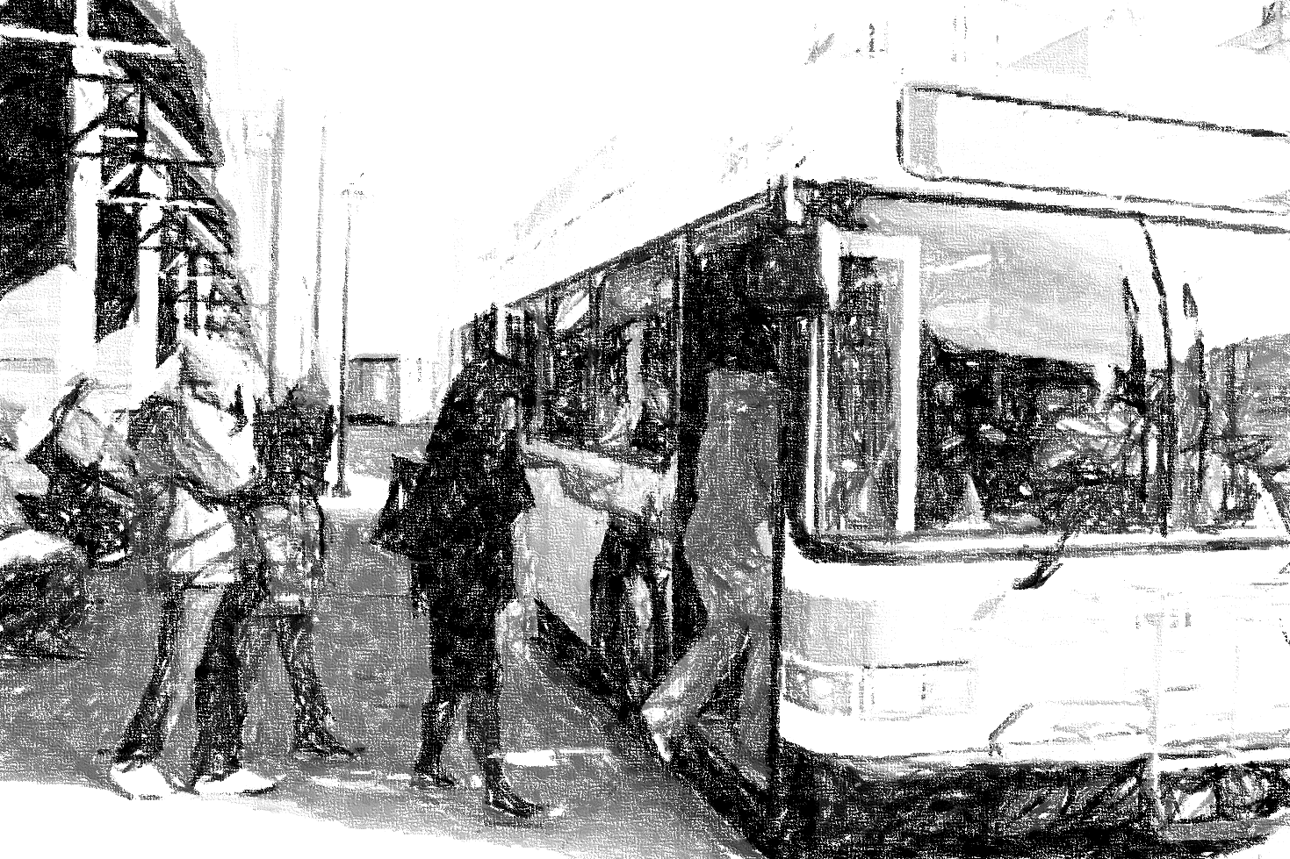
Questions and Comments
Somewhere Special
In Maine
Notes:
Thank you and if you have questions or comments I will be happy to hear them now. If you think of additional comments or questions after our discussion please email or call me. My address and contact information is on the inside cover of the executive summary.
(leave business cards or copies of executive summary)

Slide 75
Implementation of Recommendations
2016 |  |  |  |  |  | 2017
January 28 | February - April | March 16 | May 1 | June 8 | July 12 | January 15 | April 15
Advisory Council Meeting Intro’ to tasks and future direction | Site Visits Technical Assistance to prepare TDP/ Application | Training Session On TDP/ Application | TDP/ Application Due Formula application Federal FY2017 monies expended July 1, 2016 to June 30 2017 | Advisory Council Meeting Review SMP and progress future directions | SMP Public Hearing | Advisory Council Meeting | New formula Application Federal FY2018 (July 1, 2017 to June 30 2018)

Slide 76
Discussion and Next Steps
Next Meeting of Council June 8, 2016
Central Agenda Item: Review of
State Management Plan
Adjourn

